Slide 1

riton
The
Notes:
Triton = messenger of the sea
Maybe smth about navigation

Slide 2
What is The Triton?
Who is it for?
The Triton is a sailboat navigation and docking assistant
For experienced and inexperienced sailors alike who want a more reliable sailing experience
That provides easier, safer trips
Unlike Competitors
Our product is integrated and multi-functional, cost-efficient, not specific to any vessel
Notes:
Note that sometimes you need more than one value proposition. For example if the beneficiary does not pay you, then you need one value proposition for your beneficiary and one for your paying customer.
Raymarine differences:
Expense
Not integrated, not multi-functional
Intended for larger, motorized vessels

Slide 3
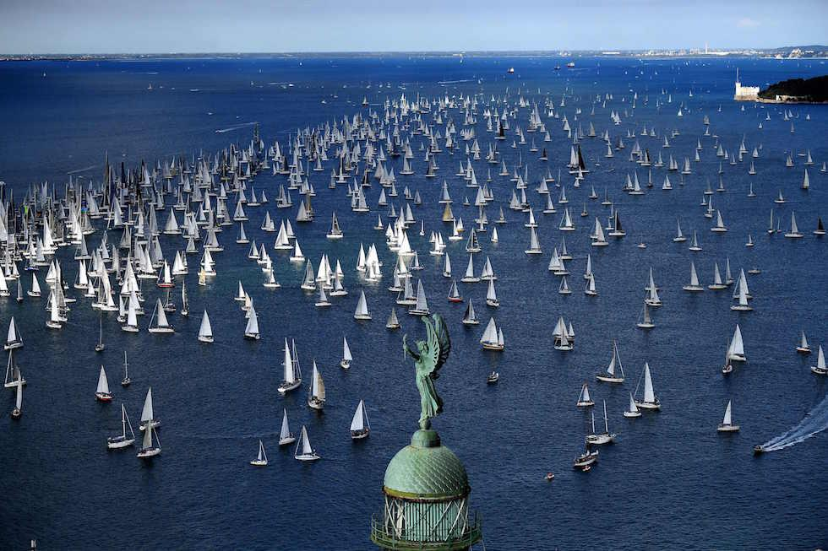
Why This Matters
Sailing in a crowded harbor or racing alongside other boats in close proximity is challenging,
Skipper's field of view is blocked by the main and front sails,
Docking can be difficult and dangerous to the skipper, under many conditions, such as unfavorable wind direction, current, or limited visibility.
In 2023 the United States Coast Guard reported that the top three causes for recreational boating accidents were operator inattention, improper lookout, and operator inexperience.
In 2023 alone, there were 564 deaths and 63 million dollars in damages due to boating related accidents.
We want to fix this problem!
Notes:
Lagoy’s story
Sailing in a crowded harbor or racing alongside other boats in close proximity is challenging, especially when sailing singlehandedly. Oftentimes, the skipper's field of view is blocked by the main and front sails, so it is difficult to maintain a visual on obstructions or other boats. Additionally, docking under sail or even under power can present difficulties to the skipper, under many conditions, such as unfavorable wind direction, current, or limited visibility. This project aims to develop a robust and portable sensor system that will aid sailors while underway and docking, and present the status to the user via a BLE connected iOS app. The sensor system can potentially be used in the future to optimize skipper sailing performance.
Research sailboat incidents
Inexperienced sailors causing accidents
Pull from PDRR (Why this is a problem, how we solve it)
When sailing alongside other boats in busy and crowded waters, sailors often have to make split second decisions, where any mistake could result in thousands of dollars in damages and potentially death. In 2023 the United States Coast Guard reported that the top three causes for recreational boating accidents were operator inattention, improper lookout, and operator inexperience. Overall in 2023 alone there were 564 deaths and 63 million dollars in damages due to boating related accidents.^{[5]} Sailing often has an incredibly high learning curve for new and experienced sailors alike and leaves little margin for error. Triton aims to solve some of these issues and help lower the learning curve for sailing by providing sailors with an additional layer of safety and accessibility not often afforded to boats of this kind. The system is designed to be easily integrated into any sailboat, taking only a few minutes to install. Triton aims to assist sailors with docking procedures, sailing protocol, detecting obstacles, accessibility, and recommending course adjustments to the user through a mobile app. Through various sensors, Triton will be able to collect the necessary data to best predict sailing conditions and with the oversight of the sailor, act as a second set of eyes in the event of an operator oversight.

Slide 4
The Triton
A multi-sensor system that assists the nautical navigation and docking for sailboats.
Aiming to make sailboating a more beginner friendly activity, as well as help experienced boaters in their travels.
Key Aspects
Lightweight, easy to install and easy to uninstall
Adaptable to a wide gamut of vessels
Recommends how to react in different situations
Technological Solutions
BLE: For communication between main object
GPS: For routing and forecasting
Anemometer: For monitoring wind speed
Radar/LiDAR: For object detection
Notes:
Special sauce
Lightweight
Easy to install, easy to uninstall
Adaptable to different vessels
Recommendations on how do react to approaching vehicles/objects/etc
Technology solution
BLE
GPS
Anemometer

Slide 5
System (HW and SW)
General Metrics:
The system will collect wind speed, speed over ground, and speed through water.
The proximity sensors will detect obstacles between one (1) meter and five (5) meters, or five (5) to one hundred (100) meters away.
All physical components of the system, including housing, will weigh less than twenty-five (25) pounds in total.
The battery for the system will last at least three (3) days on a full charge.
Weatherproof rating of at least IP68.
GPS accurate within twenty (20) meters.
Software
iOS Application (Swift)
Embedded Software (C)
Hardware
Bluetooth Low Energy
Temperature sensors
Anemometer
Radar
Telescoping pole

Slide 6
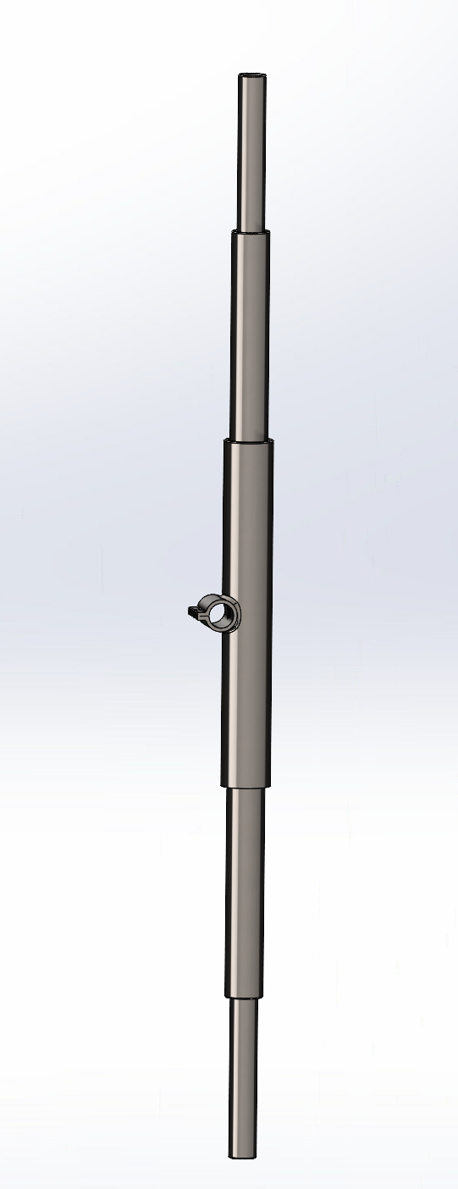
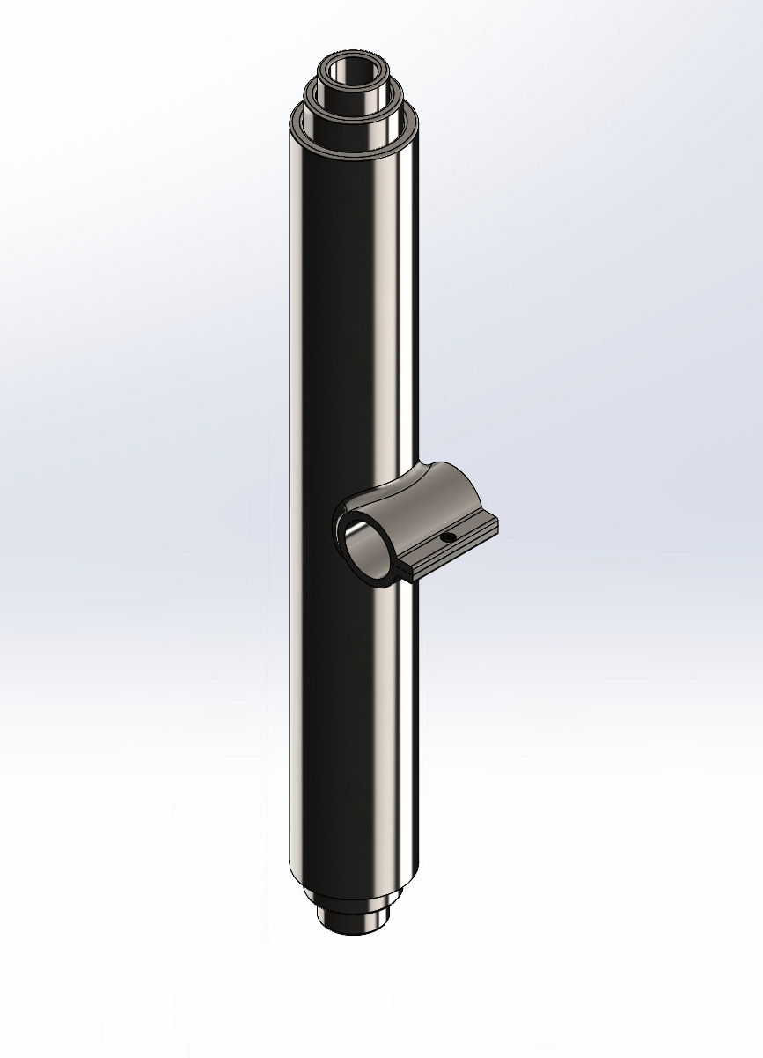
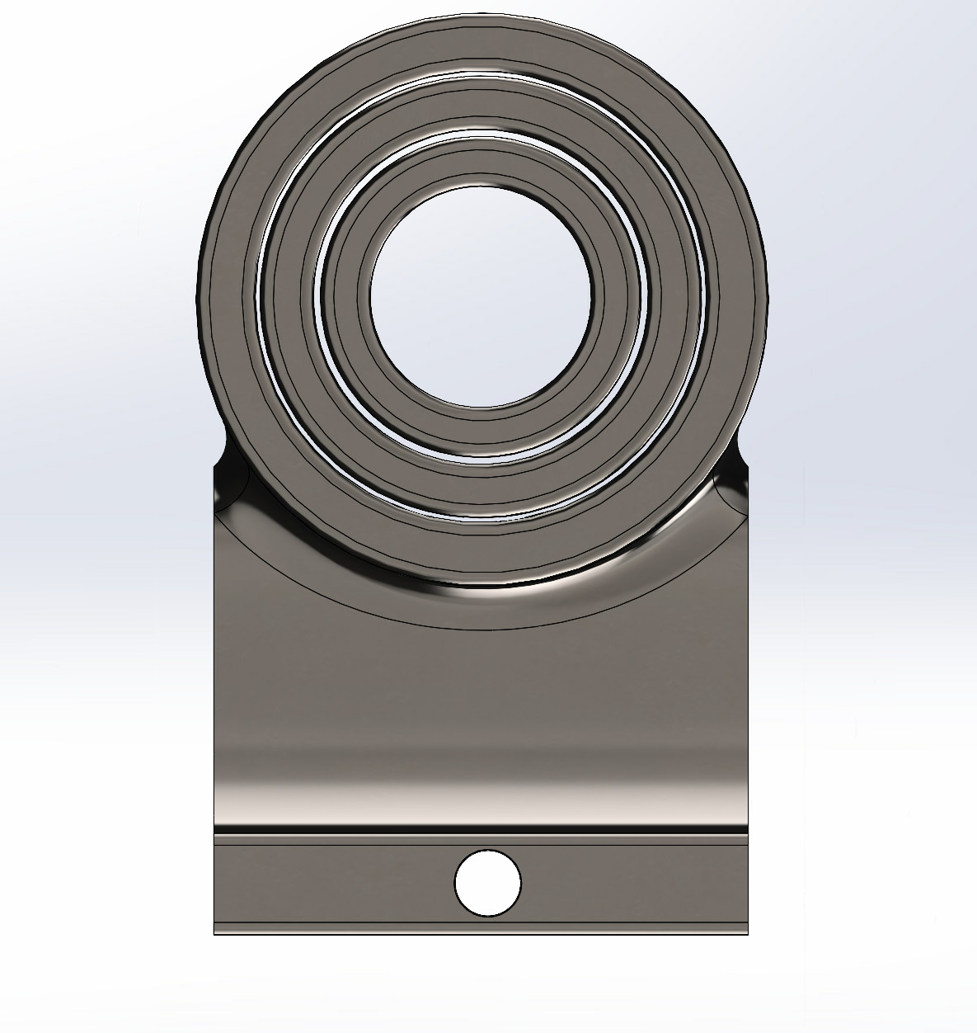
Hardware Implementation
Notes:
Hardware implementation slide
Maybe bring up here the two different CPU placements we’ve discussed
Kevin’s sketches of clamp → CAD model?
Ley monday night
Diego to modify the current design

Slide 7
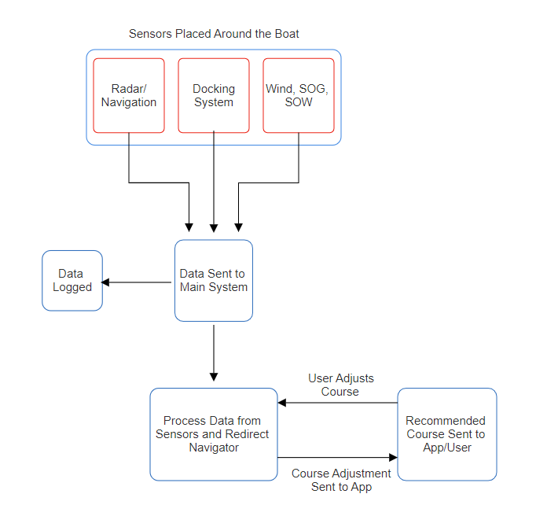
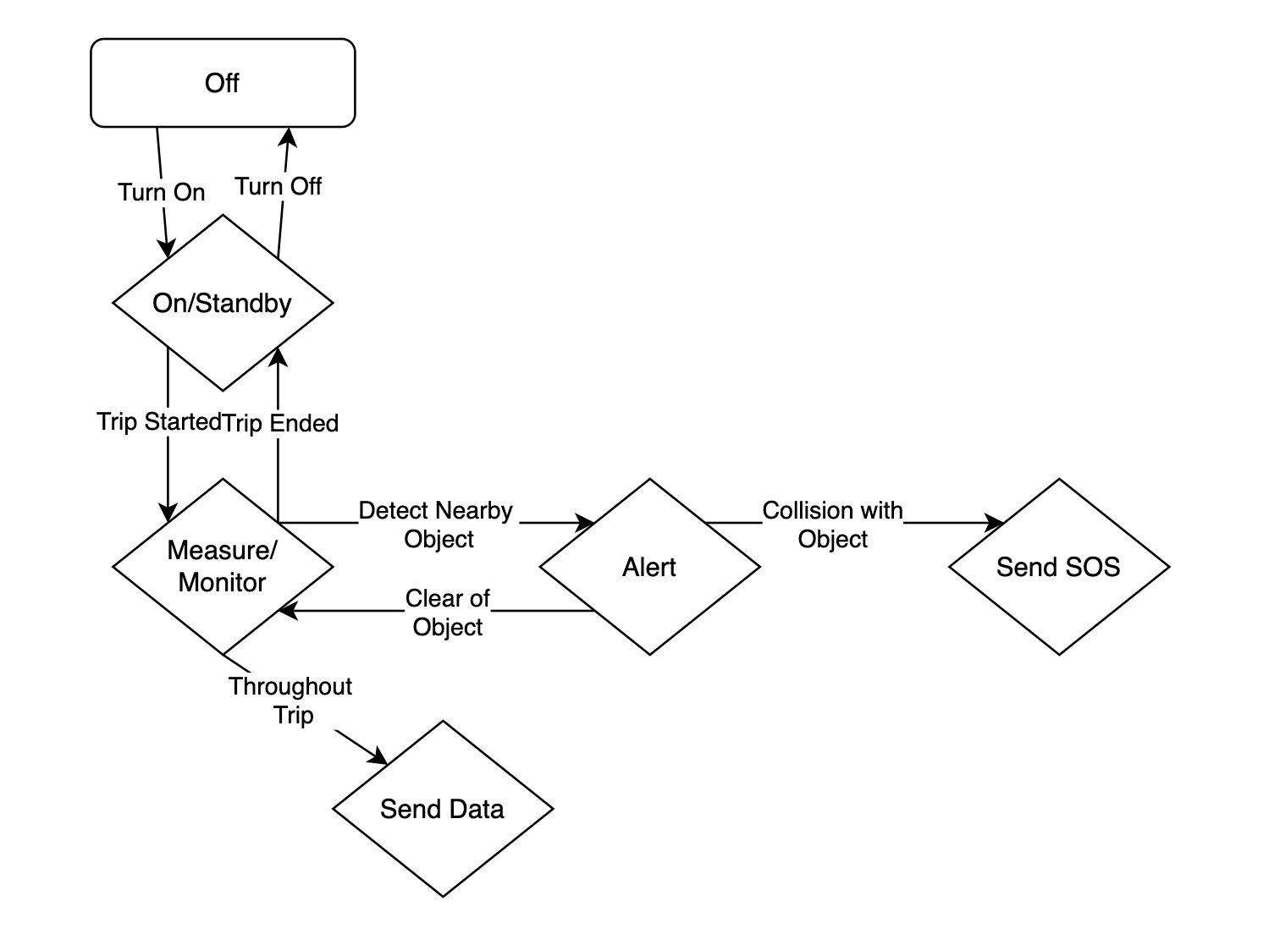
System Implementation
Notes:
Software implementation slide
Keep two code flow diagrams

Slide 8
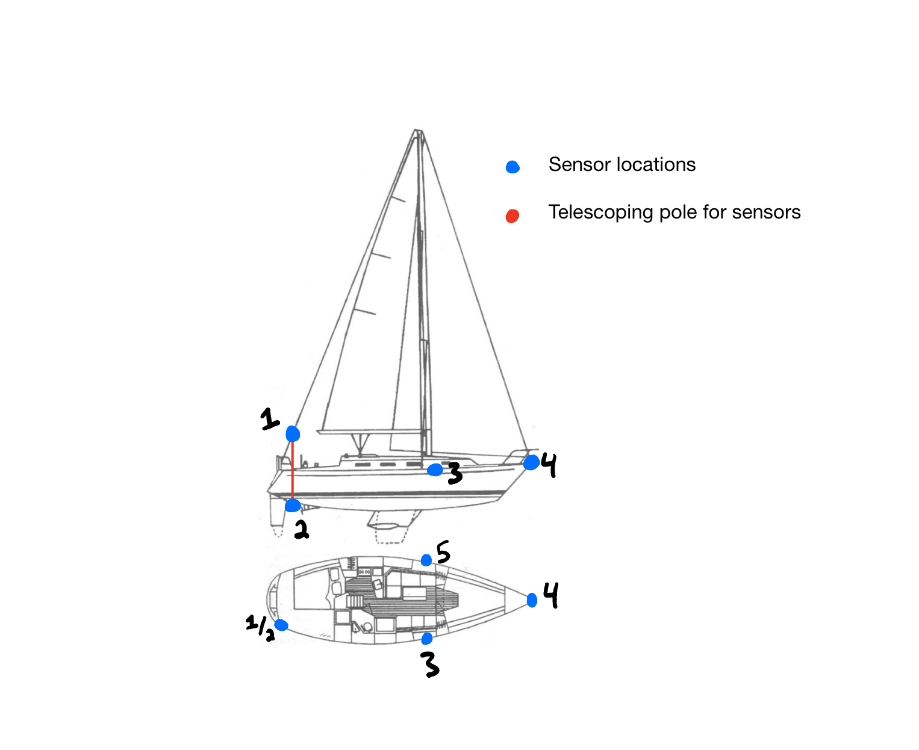
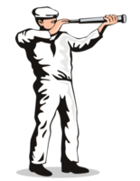
The User
Story
How would you be able to use your Triton?
Anemometer (Wind Speed)
Pitot Tube (STW)
3,4,5. LIDAR (Docking)
Notes:
Describe your essential user stories (without them, the product won’t be useful)
Either with your own purchased model or from your local boating club, you can carry your Triton on board. With our clamping system you can mount the 3 object sensors on the front and sides of your boat wherever it is most convenient. You can then mount the telescoping pole near the back of your boat, raising and lowering the two ends, once securely attached to the vessel. And now you’re done! The sensors will work to process the data they receive and use your phone to alert you of any nearby objects and provide recommendations for avoiding collisions

Slide 9
Reach Goals
Make the app platform agnostic
Create a custom PCB for the product
Offload data to the cloud for users to keep past trips accessible
Have our system integrated with autonomous sailing group
Notes:
Cloud
Keep track of past trips
Keep track of timing
Custom PCB
Android companion app

Slide 10
Thank you!
Any comments or questions?

